Slide 1
Introduction to Linear Programming

Slide 2
Introduction
Many management decisions involve making the most effective use of limited resources
Linear programming (LP)
  Widely used mathematical modeling technique
  Planning and decision making relative to resource allocation
Broader field of mathematical programming
  Here programming refers to modeling and solving a problem mathematically

Slide 3
Requirements of a
Linear Programming Problem
Four properties in common
  Seek to maximize or minimize some quantity (the objective function)
  Restrictions or constraints are present
  Alternative courses of action are available
  Linear equations or inequalities

Slide 4
Formulating LP Problems
Developing a mathematical model to represent the managerial problem
Steps in formulating a LP problem
  Completely understand the managerial problem being faced
  Identify the objective and the constraints
  Define the decision variables
  Use the decision variables to write mathematical expressions for the objective function and the constraints

Slide 5
Formulating LP Problems
Common LP application – product mix problem
Two or more products are produced using limited resources
Maximize profit based on the profit contribution per unit of each product
Determine how many units of each product to produce

Slide 6
Flair Furniture Company
Flair Furniture produces inexpensive tables and chairs
Processes are similar, both require carpentry work and painting and varnishing
  Each table takes 4 hours of carpentry and 2 hours of painting and varnishing
  Each chair requires 3 of carpentry and 1 hour of painting and varnishing
  There are 240 hours of carpentry time available and 100 hours of painting and varnishing
  Each table yields a profit of $70 and each chair a profit of $50

Slide 7
Flair Furniture Company
The company wants to determine the best combination of tables and chairs to produce to reach the maximum profit
TABLE 7.2
 | HOURS REQUIRED TO PRODUCE 1 UNIT
DEPARTMENT | (T) TABLES | (C) CHAIRS | AVAILABLE HOURS THIS WEEK
Carpentry | 4 | 3 | 240
Painting and varnishing | 2 | 1 | 100
Profit per unit | $70 | $50

Slide 8
Flair Furniture Company
The objective is
Maximize profit
The constraints are
  The hours of carpentry time used cannot exceed 240 hours per week
  The hours of painting and varnishing time used cannot exceed 100 hours per week
The decision variables are
T = number of tables to be produced per week
C = number of chairs to be produced per week

Slide 9
Flair Furniture Company
Create objective function in terms of T and C
Maximize profit = $70T + $50C
Develop mathematical relationships for the two constraints
  For carpentry, total time used is
(4 hours per table)(Number of tables produced)
+ (3 hours per chair)(Number of chairs produced)
  First constraint is
Carpentry time used ≤ Carpentry time available
4T + 3C ≤ 240 (hours of carpentry time)

Slide 10
Flair Furniture Company
Similarly
Painting and varnishing time used
≤ Painting and varnishing time available
2 T + 1C ≤ 100 (hours of painting and varnishing time)
This means that each table produced requires two hours of painting and varnishing time
  Both of these constraints restrict production capacity and affect total profit

Slide 11
Flair Furniture Company
The values for T and C must be nonnegative
T ≥ 0 (number of tables produced is greater than or equal to 0)
C ≥ 0 (number of chairs produced is greater than or equal to 0)
The complete problem stated mathematically
Maximize profit = $70T + $50C
subject to
4T + 3C ≤ 240 (carpentry constraint)
2T + 1C ≤ 100 (painting and varnishing constraint)
T, C ≥ 0 (non-negativity constraint)

Slide 12
Graphical Solution to an
LP Problem
Easiest way to solve a small LP problems is graphically
Only works when there are just two decision variables
  Not possible to plot a solution for more than two variables
Provides valuable insight into how other approaches work
Nonnegativity constraints mean that we are always working in the first (or northeast) quadrant of a graph

Slide 13
Graphical Representation of Constraints
FIGURE 7.1 – Quadrant Containing All Positive Values
C
100 –
–
80 –
–
60 –
–
40 –
–
20 –
–
This Axis Represents the Constraint T ≥ 0
Number of Chairs
This Axis Represents the Constraint C ≥ 0
| | | | | | | | | | | |
0 20 40 60 80 100
T
Number of Tables

Slide 14
Graphical Representation of Constraints
The first step is to identify a set or region of feasible solutions
Plot each constraint equation on a graph
Graph the equality portion of the constraint equations
4T + 3C = 240
Solve for the axis intercepts and draw the line

Slide 15
Graphical Representation of Constraints
When Flair produces no tables, the carpentry constraint is:
4(0) + 3C = 240
3C = 240
C = 80
Similarly for no chairs:
4T + 3(0) = 240
4T = 240
T = 60
  This line is shown on the following graph

Slide 16
Graphical Representation of Constraints
FIGURE 7.2 – Graph of Carpentry Constraint Equation
C
100 –
–
80 –
–
60 –
–
40 –
–
20 –
–
(T = 0, C = 80)
Number of Chairs
(T = 60, C = 0)
| | | | | | | | | | | |
0 20 40 60 80 100
T
Number of Tables

Slide 17
Graphical Representation of Constraints
FIGURE 7.3 – Region that Satisfies the Carpentry Constraint
Any point on or below the constraint plot will not violate the restriction
Any point above the plot will violate the restriction
C
100 –
–
80 –
–
60 –
–
40 –
–
20 –
–
Number of Chairs
(30, 40)
(70, 40)
(30, 20)
| | | | | | | | | | | |
0 20 40 60 80 100
T
Number of Tables

Slide 18
Graphical Representation of Constraints
The point (30, 40) lies on the line and exactly satisfies the constraint
4(30) + 3(40) = 240
The point (30, 20) lies below the line and satisfies the constraint
4(30) + 3(20) = 180
The point (70, 40) lies above the line and does not satisfy the constraint
4(70) + 3(40) = 400

Slide 19
Graphical Representation of Constraints
FIGURE 7.4 – Region that Satisfies the Painting and Varnishing Constraint
C
100 –
–
80 –
–
60 –
–
40 –
–
20 –
–
(T = 0, C = 100)
Number of Chairs
(T = 50, C = 0)
| | | | | | | | | | | |
0 20 40 60 80 100
T
Number of Tables

Slide 20
Graphical Representation of Constraints
To produce tables and chairs, both departments must be used
Find a solution that satisfies both constraints simultaneously
A new graph shows both constraint plots
The feasible region is where all constraints are satisfied
  Any point inside this region is a feasible solution
  Any point outside the region is an infeasible solution

Slide 21
Graphical Representation of Constraints
FIGURE 7.5 – Feasible Solution Region
C
100 –
–
80 –
–
60 –
–
40 –
–
20 –
–
Painting/Varnishing Constraint
Number of Chairs
Feasible Region
Carpentry Constraint
| | | | | | | | | | | |
0 20 40 60 80 100
T
Number of Tables

Slide 22
Graphical Representation of Constraints
For the point (30, 20)
Carpentry constraint | 4T + 3C ≤ 240 hours available (4)(30) + (3)(20) = 180 hours used
Painting constraint | 2T + 1C ≤ 100 hours available (2)(30) + (1)(20) = 80 hours used
✓
✓
For the point (70, 40)
Carpentry constraint | 4T + 3C ≤ 240 hours available (4)(70) + (3)(40) = 400 hours used
Painting constraint | 2T + 1C ≤ 100 hours available (2)(70) + (1)(40) = 180 hours used
✗
✗

Slide 23
Graphical Representation of Constraints
For the point (50, 5)
Carpentry constraint | 4T + 3C ≤ 240 hours available (4)(50) + (3)(5) = 215 hours used
Painting constraint | 2T + 1C ≤ 100 hours available (2)(50) + (1)(5) = 105 hours used
✓
✗

Slide 24
Isoprofit Line Solution Method
Find the optimal solution from the many possible solutions
Speediest method is to use the isoprofit line
Starting with a small possible profit value, graph the objective function
Move the objective function line in the direction of increasing profit while maintaining the slope
The last point it touches in the feasible region is the optimal solution

Slide 25
Isoprofit Line Solution Method
Choose a profit of $2,100
The objective function is
$2,100 = 70T + 50C
Solving for the axis intercepts, draw the graph
Obviously not the best possible solution
Further graphs can be created using larger profits
  The further we move from the origin, the larger the profit
The highest profit ($4,100) will be generated when the isoprofit line passes through the point (30, 40)

Slide 26
Isoprofit Line Solution Method
FIGURE 7.6 – Profit line of $2,100
C
100 –
–
80 –
–
60 –
–
40 –
–
20 –
–
Number of Chairs
$2,100 = $70T + $50C
(30, 0)
| | | | | | | | | | | |
0 20 40 60 80 100
T
Number of Tables

Slide 27
Isoprofit Line Solution Method
FIGURE 7.7 – Four Isoprofit Lines
C
100 –
–
80 –
–
60 –
–
40 –
–
20 –
–
$3,500 = $70T + $50C
$2,800 = $70T + $50C
Number of Chairs
$2,100 = $70T + $50C
$4,200 = $70T + $50C
| | | | | | | | | | | |
0 20 40 60 80 100
T
Number of Tables

Slide 28
Isoprofit Line Solution Method
FIGURE 7.8 – Optimal Solution
C
100 –
–
80 –
–
60 –
–
40 –
–
20 –
–
Maximum Profit Line
Number of Chairs
Optimal Solution Point
(T = 30, C = 40)
$4,100 = $70T + $50C
| | | | | | | | | | | |
0 20 40 60 80 100
T
Number of Tables

Slide 29
Corner Point Solution Method
The corner point method for solving LP problems
Look at the profit at every corner point of the feasible region
Mathematical theory is that an optimal solution must lie at one of the corner points or extreme points

Slide 30
Corner Point Solution Method
FIGURE 7.9 – Four Corner Points of the Feasible Region
C
100 –
–
80 –
–
60 –
–
40 –
–
20 –
–
(0, 80)
Number of Chairs
(?)
(50, 0)
| | | | | | | | | | | |
0 20 40 60 80 100
(0, 0)
T
Number of Tables

Slide 31
Corner Point Solution Method
Solve for the intersection of the two constraint lines
Using the elimination method to solve simultaneous equations method, select a variable to be eliminated
Eliminate T by multiplying the second equation by –2 and add it to the first equation
– 2(2T + 1C = 100) = – 4T – 2C = –200
4T + 3C = 240 (carpentry)
– 4T – 2C = –200 (painting)
C = 40

Slide 32
Corner Point Solution Method
Substitute C = 40 into either equation to solve for T
Thus the corner point is (30, 40)
4T + 3(40) = 240
4T + 120 = 240
4T = 120
T = 30
TABLE 7.3 – Feasible Corner Points and Profits
NUMBER OF TABLES (T) | NUMBER OF CHAIRS (C) | PROFIT = $70T + $50C
0 | 0 | $0
50 | 0 | $3,500
0 | 80 | $4,000
30 | 40 | $4,100
Highest profit – Optimal Solution

Slide 33
Using QM for Windows
Select the Linear Programming module
Specify the number of constraints (non-negativity is assumed)
Specify the number of decision variables
Specify whether the objective is to be maximized or minimized
For Flair Furniture there are two constraints, two decision variables, and the objective is to maximize profit

Slide 34
Using QM for Windows
PROGRAM 7.1A – QM for Windows Linear Programming Computer Input Screen

Slide 35
Using QM for Windows
PROGRAM 7.1B – QM for Windows Data Input

Slide 36
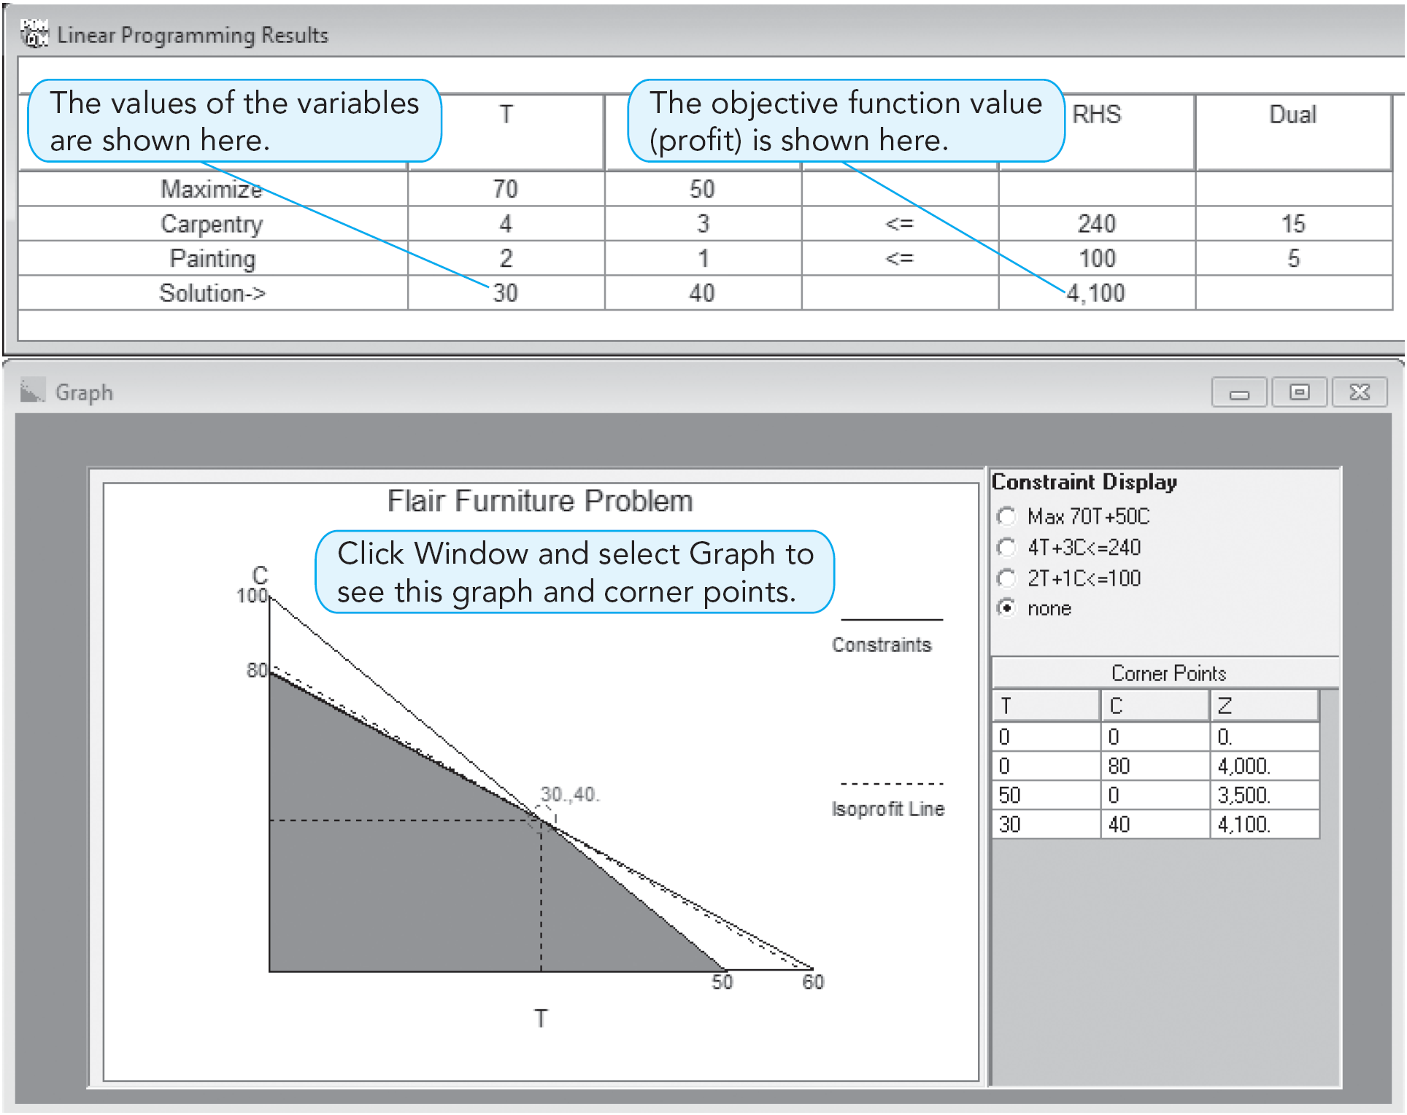
Using QM for Windows
PROGRAM 7.1C –
QM for Windows
Output and Graph

Slide 37
Example of Integer Programming
Company produces two products, old-fashioned chandeliers and ceiling fans
Both require a two-step production process involving wiring and assembly
  It takes about 2 hours to wire each chandelier and 3 hours to wire a ceiling fan
  Final assembly of the chandeliers and fans requires 6 and 5 hours, respectively
  Only 12 hours of wiring time and 30 hours of assembly time are available
  Each chandelier produced nets the firm $7 and each fan $6

Slide 38
Example of Integer Programming
Production mix LP formulation
Maximize profit = $7X₁ + $6X₂
subject to 2X₁ + 3X₂ ≤ 12 (wiring hours)
6X₁ + 5X₂ ≤ 30 (assembly hours)
X₁, X₂ ≥ 0
where
X₁ = number of chandeliers produced
X₂ = number of ceiling fans produced

Slide 39
Example of Integer Programming
FIGURE 10.1 – Harrison Electric Problem
6 –
5 –
4 –
3 –
2 –
1 –
X₂
6X₁ + 5X₂ ≤ 30
+ = Possible Integer Solution
+
Optimal LP Solution
(X₁= 3.75, X₂ = 1.5, Profit = $35.25
+
+
+
+
+
+
+
2X₁ + 3X₂ ≤ 12
| | | | | |
0 1 2 3 4 5 6
X₁

Slide 40
Example of Integer Programming
Production planner recognizes this is an integer problem
  First attempt at solving it is to round the values to X₁ = 4 and X₂ = 2
  However, this is not feasible
  Rounding X₂ down to 1 gives a feasible solution, but it may not be optimal
This could be solved using the enumeration method
  Generally not possible for large problems

Slide 41
Example of Integer Programming
CHANDELIERS (X₁) | CEILING FANS (X₂) | PROFIT ($7X₁ + $6X₂)
0 | 0 | $0
1 | 0 | 7
2 | 0 | 14
3 | 0 | 21
4 | 0 | 28
5 | 0 | 35
0 | 1 | 6
1 | 1 | 13
2 | 1 | 20
3 | 1 | 27
4 | 1 | 34
0 | 2 | 12
1 | 2 | 19
2 | 2 | 26
3 | 2 | 33
0 | 3 | 18
1 | 3 | 25
0 | 4 | 24
TABLE 10.1 – Integer Solutions to the Harrison Electric Company Problem
Optimal solution to integer programming problem
Solution if rounding is used

Slide 42
Harrison Electric Company Example of Integer Programming
CHANDELIERS (X₁) | CEILING FANS (X₂) | PROFIT ($7X₁ + $6X₂)
0 | 0 | $0
1 | 0 | 7
2 | 0 | 14
3 | 0 | 21
4 | 0 | 28
5 | 0 | 35
0 | 1 | 6
1 | 1 | 13
2 | 1 | 20
3 | 1 | 27
4 | 1 | 34
0 | 2 | 12
1 | 2 | 19
2 | 2 | 26
3 | 2 | 33
0 | 3 | 18
1 | 3 | 25
0 | 4 | 24
TABLE 10.1 – Integer Solutions to the Harrison Electric Company Problem
Optimal solution to integer programming problem
The optimal integer solution is less than the optimal LP solution of $35.25
An integer solution can never be better than the LP solution and is usually a lesser value
Solution if rounding is used

Slide 43
Example
The dean of the Caucasus School of Business must plan the school’s course offerings for the fall semester.
Student demands make it necessary to offer at least 30 undergraduate and 20 graduate courses in the term.
Faculty contracts also dictate that at least 60 courses be offered in total.
Each undergraduate course taught costs the college an average of $2,500 in faculty wages, and each graduate course costs $3,000.
How many undergraduate and graduate courses should be taught in the fall so that total faculty salaries are kept to a minimum?

Slide 44
B>=30
M>=20
B+M>=60
Cost=2500B+3000M minimize

Slide 45
Employee Scheduling Applications
Labor Planning
  Address staffing needs over a particular time
  Especially useful when there is some flexibility in assigning workers that require overlapping or interchangeable talents

Slide 46
Bank
Bank requires between 10 and 18 tellers depending on the time of day
The bank wants a schedule that will minimize total personnel costs
  Lunch time from noon to 2 pm is generally the busiest
  Bank employs 12 full-time tellers, many part-time workers

Slide 47
Bank
  Part-time workers must put in exactly four hours per day, can start anytime between 9 am and 1 pm, and are inexpensive
  Full-time workers work from 9 am to 5 pm and have 1 hour for lunch
  Part-time hours are limited to a maximum of 50% of the day’s total requirements
  Part-timers earn $8 per hour on average
  Full-timers earn $100 per day on average
  It will release one or more of its full-time tellers if it is profitable to do so

Slide 48
Bank
Labor requirements
TABLE 8.4
TIME PERIOD | NUMBER OF TELLERS REQUIRED
9 am – 10 am | 10
10 am – 11 am | 12
11 am – Noon | 14
Noon – 1 pm | 16
1 pm – 2 pm | 18
2 pm – 3 pm | 17
3 pm – 4 pm | 15
4 pm – 5 pm | 10

Slide 49
Bank
Variables
F = full-time tellers
P₁ = part-timers starting at 9 am (leaving at 1 pm)
P₂ = part-timers starting at 10 am (leaving at 2 pm)
P₃ = part-timers starting at 11 am (leaving at 3 pm)
P₄ = part-timers starting at noon (leaving at 4 pm)
P₅ = part-timers starting at 1 pm (leaving at 5 pm)
Objective
Minimize total daily personnel cost
= $100F + $32(P₁ + P₂ + P₃ + P₄ + P₅)

Slide 50
Bank
Constraints
F | + P₁ |  |  |  |  | ≥ | 10 | (9 am – 10 am needs)
F | + P₁ | + P₂ |  |  |  | ≥ | 12 | (11 am – noon needs)
0.5F | + P₁ | + P₂ | + P₃ |  |  | ≥ | 14 | (1 pm – 2 pm needs)
0.5F | + P₁ | + P₂ | + P₃ | + P₄ |  | ≥ | 16 | (noon – 1 pm needs)
F |  | + P₂ | + P₃ | + P₄ | + P₅ | ≥ | 18 | (1 pm – 2 pm needs)
F |  |  | + P₃ | + P₄ | + P₅ | ≥ | 17 | (2 pm – 3 pm needs)
F |  |  |  | + P₄ | + P₅ | ≥ | 15 | (3 pm – 4 pm needs)
F |  |  |  |  | + P₅ | ≥ | 10 | (4 pm – 5 pm needs)
F |  |  |  |  |  | ≤ | 12 | (12 full-time tellers)
 | 4P₁ | + 4P₂ | + 4P₃ | + 4P₄ | + 4P₅ | ≤ | 0.50(112) | (max 50% part-timers)
F, P₁, P₂, P₃, P₄, P₅ |  |  |  |  |  | ≥ | 0 | (nonnegativity)

Slide 51
Bank
Alternate solutions are possible for this problem
Each has the same total cost – $1,448/day
 | SOLUTION 1 | SOLUTION 2
Full-Time Tellers | 10 | 10
P₁ Tellers | 0 | 6
P₂ Tellers | 7 | 1
P₃ Tellers | 2 | 2
P₄ Tellers | 5 | 5
P₅ Tellers | 0 | 0

