Slide 1
Wireless Based Attacks

Slide 2
Objectives
Explain how wireless networks work
Discuss threats against wireless networks
Understand how to protect yourself when on an untrusted wireless network

Slide 3
Wireless is everywhere!
Some organizations don’t even put wired ports in anymore
Nearly all devices out there come with some kind of wireless connection
We get frustrated if we don’t have signal

Slide 4
How wireless works
What do we need to know?
Channels – 20Ghz, 40Ghz, 80Ghz
Lower the frequency, lower the speed
Base station serves an SSID
Client connects to an SSID (Service Set Identifier)
SSID can be really most anything!

Slide 5
Threats to clients
Connecting to a spoofed SSID
Attacker/owner can sniff traffic
Connecting to unsecured SSID (open)
Attacker could perform a man in the middle attack
De-authentication attacks
Used to disconnect any device from any network within specific range

Slide 6
De-authentication attacks
Hacker sends de-authentication packets to the router pretending to be the target machine (spoofing it’s MAC address)
At the same time, the hacker sends packets to the target machine (pretending to be the router) telling it that it needs to re-authenticate itself

Slide 7
De-authentication attacks
Getting MAC address of accesses point and connected device

Slide 8
De-authentication attacks

Slide 9
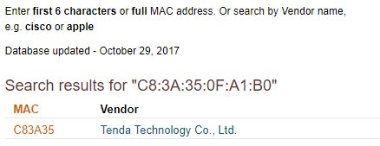
Scanning wireless network

Slide 10
Sniffing wireless network

Slide 11
Threats to infrastructure
Spoofing SSIDs
WPS – Wifi protected setup
Usernames/passwords
Backdoors
What was protected through wires, now allows anyone to connect

Slide 12
Defenses
Use trusted networks
Secure SSIDs using well known and secure protocols
Only broadcast where you intent to use the signal (physicality)

