Slide 1
Domain name system

Slide 2
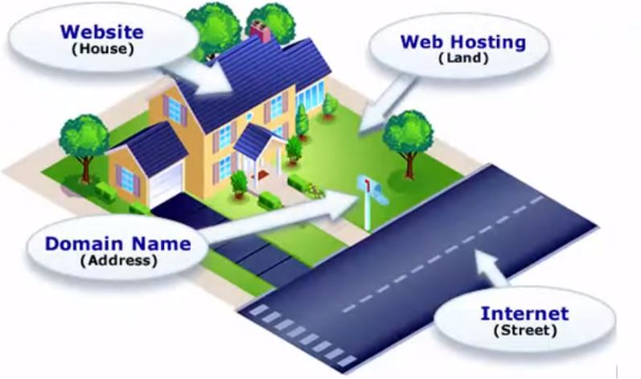
How web works

Slide 3
Domain Name System (DNS)
The internet is made up of computers that are set up in large networks around the world
These networks are connected by a web of underground and sometimes undersea wires
Computers communicate with each other using strings of numbers – Internet protocol or IP Addresses
IP functions like street address – identify where device is located on the internet

Slide 4
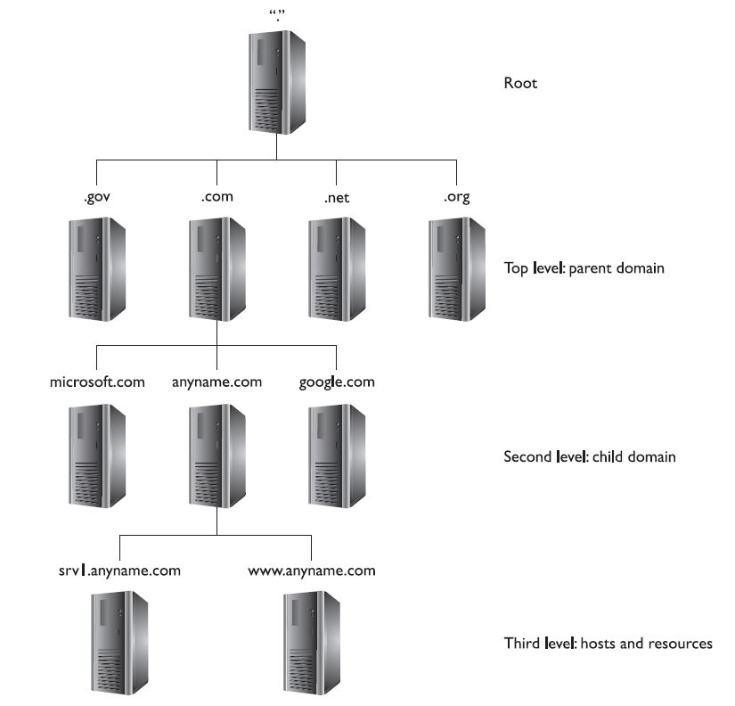

Slide 5
Domain Name System (DNS)
For human it is hard to remember all these random bunch of numbers
DNS translates human – friendly domain names
Once we enter domain name, browser and PC determine if this domain has related IP address in browser’s database
If domain was not found in local memory, browser goes out to the internet where it asks a series of DNS servers
(if they have this domain name in their database)

Slide 6
Attack preparation
Gathering information about the target
Each of the DNS records can give bit of information about the target
The more information attacker get from the upfront, the better attacker is prepared for the attack
Security of DNS server is very important and sometimes ignored by many network administrators

Slide 7
Common DNS records types
A (address) record - maps a domain name to the IP address
SOA (Start of Authority) – DNS server responsible for the domain info
NS (Name server) – identifies name servers for domain
PTR (Pointers) – maps IP address to a domain name
MX (Mail Exchange) – mail server for domain
CNAME (canonical Name) – additional names for the domain (www.)

Slide 8
Sources and materials
What is DNS: https://www.youtube.com/watch?v=72snZctFFtA
DNS Dumpster: https://dnsdumpster.com/
DNS Stuff: https://tools.dnsstuff.com/

